Slide 1
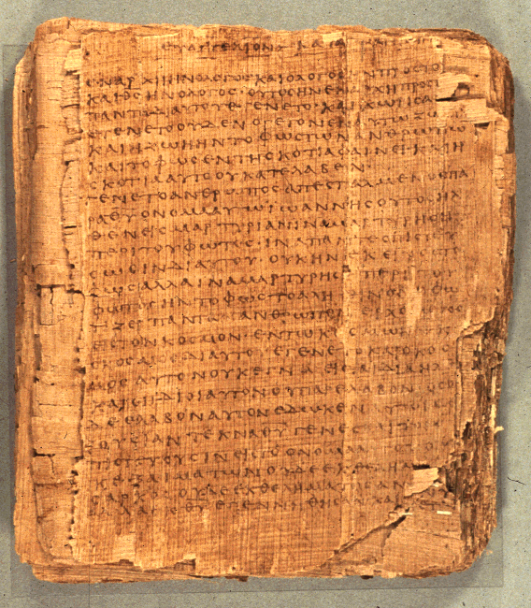
Comprehending the Psalms
Dr. Rodney K. Duke

Slide 2
CLASS 3
Assign: [Focus on #3 and #5, #4 is a reading]
Daily Journal
Assign. #3. Formulate a tentative reading strategy
Assign. #4. Learn about the purity and holiness systems.
Assign. #5. Develop skill of identifying and outlining the 3 basic types of psalms.
Day Objectives:
Explain the cultic symbol system behind the sacrificial system.
Learn to identify and outline the 3 basic psalm types.

Slide 3
JOURNAL THOUGHTS & OBSERVATIONS

Slide 4
REVIEW
Purpose / Main Point for Assign. #1
Most people summarize WHAT they think a text means.
When describing a literary genre, hopefully, they start thinking about HOW it means (literary features) and WHY (its communicative intention).
Good textual interpretation follows the reverse order: WHY (intention of the genre), then HOW (key features), and then deciding WHAT it means.

Slide 5
REVIEW
Communication Chart
Speaker
Rhetorical intent
Rhetorical strategy/“rules”
Literary features
Medium
Referent
text
Form
Content
creates =
effective
communication
Reading strategy/ “rules”
= effective communication
When rhetorical strategy matches reading strategy = effective communication.
Rhetorical impact
Addressee

Slide 6
REVIEW
APPLICATION OF PROCESS OF COMMUNICATION
When reading a specific OT text:
General
1. Identify the literary genre and its function(s) in general. [WHY]
2. Identify the general literary features of that genre and their intended impact. [HOW] (Create a "Reading Strategy")
Specific
3. Identify the literary features of a specific text and their specific impact. (Apply Reading Strategy)
4. Evaluate in terms of intended function/total impact. [WHAT]

Slide 7
Define “Cult”/“Cultic”
Any tangible expressions of religion (rituals, gestures, places, objects, personnel, seasons, etc.)

Slide 8
Today Ancient Israel
Rituals
Gestures
Places
Objects
Personnel
Seasons

Slide 9
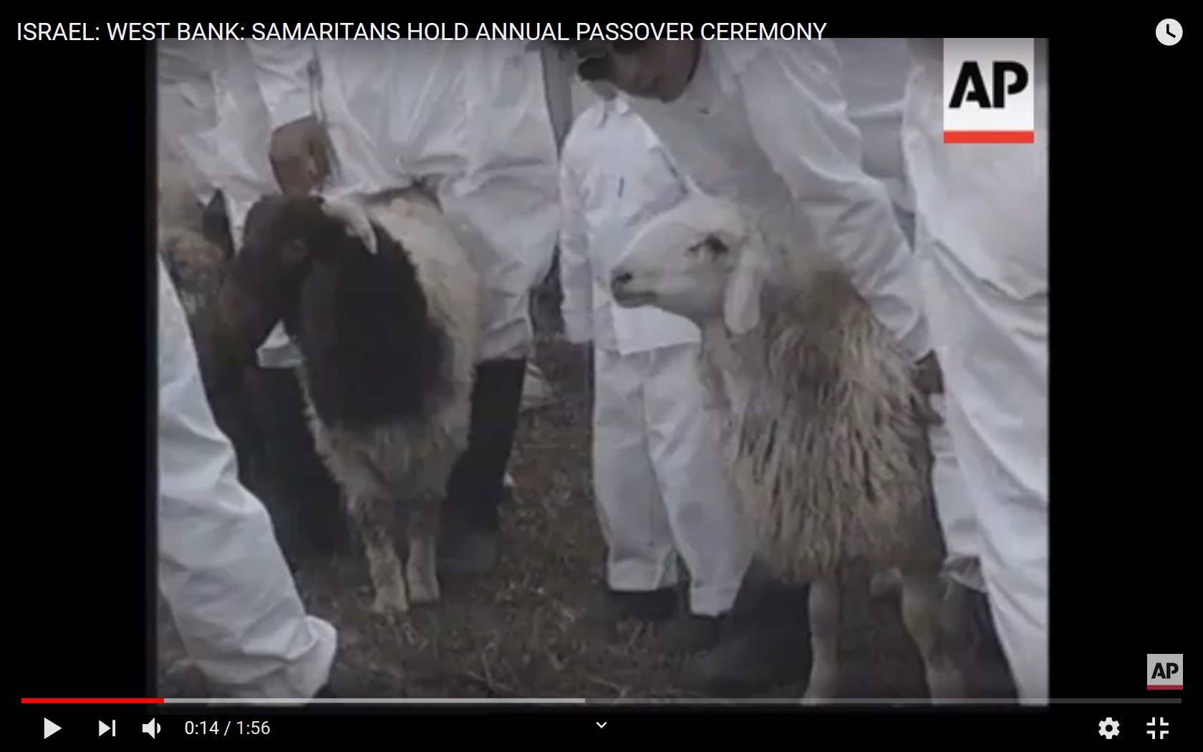
SAMARITAN VIDEO
Notes:
Start at c. 50 sec.

Slide 10
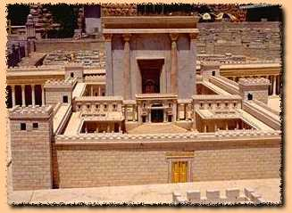
Overview
Setting of transmission and employment
1. Whatever the origin of the Psalms, they seem to have been used in the Temple worship as collected “books” of psalms.
2. The Psalms as we have them have been made very generic: enemies, illnesses, threats, occasions of joy, etc. are stated in general terms.
3. As a result, the Psalms have become applicable to all people.

Slide 11
Hymnic Literature
H. Gunkel
#2. Obj.: Discover the formal element of different kinds of psalms.
Compare and contrast Psalms 33, 34, 74, 79, 113, and 116. (Consider: rhetorical intention; addressee; themes; mood and mood shifts; whether the speaker is reflecting on the past, present, or future; etc.)
Match up the psalms which are most alike, forming three sets of pairs.
What are the elements which are similar between the two psalms in each of your pairings?
What elements distinguish each set from the other sets of your pairs?

Slide 12
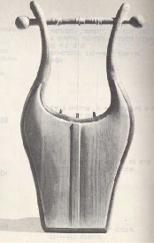
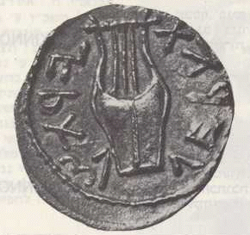
Assign. #2 Procedure:
1. In groups decide on what pairing is best and state criteria for the decision. Pick a spokesperson.
2. If your groups disagree, have a spokesperson ready to explain/defend the group’s pairings.

Slide 13
Review: Assign. 2 Procedure:
1. In groups decide on what pairing is best and state criteria for the decision. (5 min)
2. Have group spokespersons state their pairing. (2 min)
3. If differences between groups, spokesperson must defend position taken by group; or
4. Spokespersons to ID criteria by which the decision was made.
Best pairing:
Pss 74 & 79, 34 & 116,
33 & 113

Slide 14
PAIRINGS
Pss 74, 79:
Addressed to God
Intention: Get God to act
Mood shifts from lament/despair to confidence
Time orientation: present
Pss 34, 116
Addressee: God, general audience, sometimes oneself
Intention: Thanking God
Mood consistent: upbeat
Time orientation: reflects back on past
Pss 33, 113
Addressed to general audience
Intention: Praise God in general
Mood consistent: upbeat
Time orientation: rather atemporal

Slide 15
Overview
Creating a “Reading Strategy” for Psalms
1. Because of the generic nature of the Psalms, we are learning to read them “form critically,” that is, according to their use within a social setting. [Contribution of Hermann Gunkel]
A. The social setting of the temple sheds light on the function of the psalms, and
B. The forms of the psalms sheds light on the social setting (the faith and practices) of the Israelites.
2. 3 major forms found in the 150 psalms [two naming systems]
Psalms of Petition / Psalms of Lament
Psalms of Declarative Praise / Psalms of Thanksgiving
Psalms of Descriptive Praise / Hymns

Slide 16
OUTLINING PSALM TYPES
(See Handouts, pp. 18-23)
Two main naming systems:
Psalms of Petition / Psalms of Lament
Psalms of Declarative Praise / Psalms of Thanksgiving
Psalms of Descriptive Praise / Hymns

Slide 17
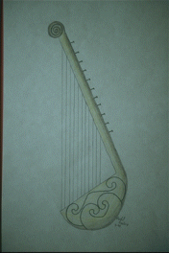
Psalms of Lament/Petition (1 of 3)
General characteristics: personal, speaker primarily addresses God, mood shifts from to despair to some hope/trust, oriented in the present setting of need or crisis
(What rhetorical difference does music make?)
I. Motifs Found in Lament Psalms (no set order)
A. Often: Introductory petition/lament (e.g. Save me, because people persecute me.)
B. Lament [Types: 1) claim innocence, 2) plea for forgiveness]
(Often from different perspectives) 1) You (God) are …
2) I am …
3) They (foes) are …
Drawing of a Lyre. Copyright Zondervan Image Archives

Slide 18
Psalms of Lament/Petition (2 of 3)
C. Petition to God
1) To take favorable notice
2) To intervene
3) Motivation
4) “Double wish”
a) against enemies (imprecation)
b) for oneself
[honest how they feel and bold]

Slide 19
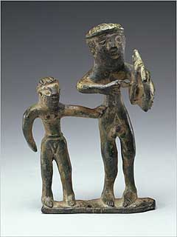
Psalms of Lament/Petition (3 of 3)
D. Confession of Trust
(Hebrew waw adversative) Look for words such as then” “now” “but” and a shift to a positive mood.
1. Specific trust elements:
a) vow of praise (more in individual laments than in communal)
b) declarative praise
Statuette of Lyre Player. Copyright: http://www.getty.edu/museum/objects/Antiquities/90_AB_6_A.htm

Slide 20
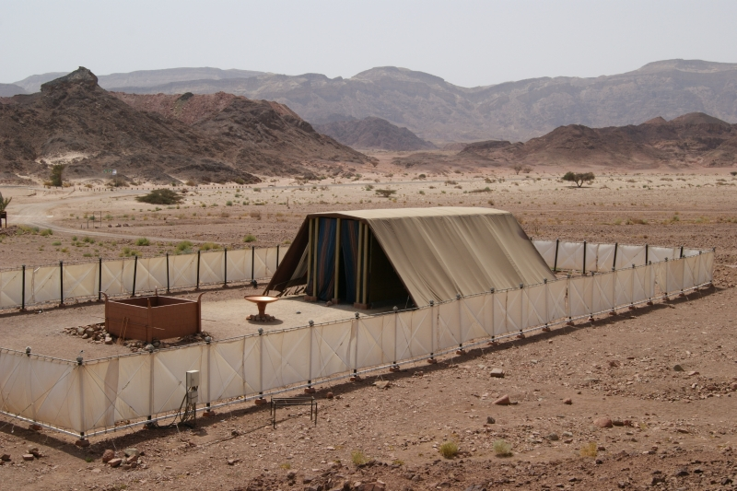
Communal Lament
‘Answer’ by God = prophetic role of priest with oracle of salvation?
Ps. 85:8
Ps. 12:5
Ps. 91:14-15
Ps. 21:8?
See 1 Samuel 1:17

Slide 21
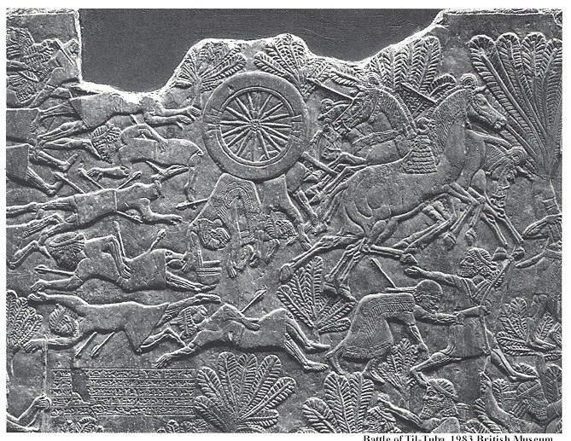
PSALM 79 (HO, p. 22)
(Communal Lament)
Setting: Destruction of Jerusalem c. 586 BCE
I. Introductory lament 1-5
A. Enemy: has done this against You 1-3
B. We: have become a reproach 4
C. You: how long angry? 5
II. Petition with motivation 6-12
A. Against enemy; reason: do not know You 6-7
B. For selves; need: compassion, help, forgiveness 8-9
C. Against enemy; reason: dishonor God 10
D. For selves: doomed without You 11
E. Against enemy; reason: reproach You 12
ABABA

Slide 22
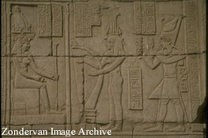
PSALM 79 (2 of 2)
(Communal Lament)
III. Expression of trust: vow of praise 13
"Then/now/but" (waw adversative) note: mood shift
"We will give testimony (thanks/praise) forever."
http://www.lava.net/college/harp/

Slide 23
PSALM 54 (1 of 2)
1) O God, by Your name save me, And by Your power vindicate me!
2) O God, hear my prayer, Give ear to the words of my mouth!
3) For strangers have arisen against me, And terrifying ones seek my life; Men who do not set God before them.

Slide 24
PSALM 54 (2 of 2)
4) Behold, God [is] the One who helps me, My Lord [is] the One who upholds my life.
5) May He return evil to those lurking for me, In Your faithfulness bring them to an end.
6) With a free-will offering I will sacrifice to You, I will thank Your name, Yahweh, because [it is] good.
7) Because from every trouble You have delivered me, And against my enemies my eye has gloated.

Slide 25
Psalms of Declarative Praise (Thanksgiving)
(1 of 2)
General
Personal, use of 1st person
Mood: consistent, joyful
Audience: usually switches between God and community
Time: in the present, the psalmist looks back to the past
Setting: celebration of todah offering with extended family and the poor
I. Motifs and Structure
A. Opening Proclamation
1. States intention to praise God (“You”)
and/or 2. (Introductory Summary)

Slide 26
Psalms of Declarative Praise (Thanksgiving)
(2 of 2)
B. Report of Deliverance
1. Trial or problem
2. Psalmists cry to God - “I cried,” “He heard”
3. The deliverance - “He delivered”
C. Conclusion
1. Renewed vow of praise
(2. Descriptive praise
(3. Instruction
May be woven into the “Report”

Slide 27
Psalm 116
(abbreviated outline; HO, p. 23)
I. Proclamation and Summary, 1-2 [note chiastic structure]
A. A) Response: love Yahweh; B) Reason: heard me
B. B) Reason: listened to me; A) Response: will call on Yahweh
II. Report, 3-11
A. Trial: near death, 3
B. Cry to Yahweh, 4
C. Deliverance [w/descriptive praise], 5-11
1. Affirmation to others, 5-6
2. Affirmation to self, 7
3. Affirmation to Yahweh, 8-9
4. Continued reflection on deliverance, 10-11
III. Conclusion, 12-19
A. Vow of Praise, 12-14
B. Affirmation and Commitment, 15-16
C. Vow of Praise repeated, 17-19
A
B
A

Slide 28
Psalms of Descriptive Praise (Hymns)
General:
Tone: impersonal (often in 3rd person)
Audience: community and God
Mood: consistently joyful
Time: atemporal
Setting: often festivals and pilgrimages
I. Motifs and Structures
(Prologue: Hallelujah = “You’ll praise God”)
A. Call to Praise
imperative: often repeated throughout psalm
B. Cause for Praise
1. Summary Statement (often 2-fold)
a. God’s majesty: Lord of Creation
b. God’s grace: Lord of history
2. Descriptive Illustrations
Drawing of a Lyre. Copyright Zondervan Image Archives

Slide 29
Psalms of Descriptive Praise (Hymns)
C. Conclusion: many options
1. Renewed call to praise
2. Exhortations
3. Petition, etc.
4. Vow of praise
(Epilogue: Hallelujah)
any

Slide 30
Psalm 113
(abbreviated outline; HO, p. 22)
I. Call to Praise, 1-3
A. Whom: Yahweh; By whom: servants; Whom, 1 (3-fold rep.)
B. Whom: Yahweh; When and Where, 2-3 [note chiasm]
1. Praise name of Yahweh
2. From now to the end [merism = always]
3. From place sun rises to sets [= everywhere]
4. Praise name of Yahweh
ABBA
II. Cause for Praise, 4-9b
A. Yahweh is over all (sovereign), 4-6
B. Yahweh Intervenes (gracious), 7-9b
III. Concluding Call to Praise, 9c

Slide 31
BACKGROUND ON PSALMS
Theological Basis and/or Implications
Each psalm has own distinct message; but some generalizations:
A. Petitions:
1. God is to be approached boldly, with complete openness
2. Even in despair, the psalmist expressed trust
B. Thanksgivings:
1. God is to be thanked by testimony before the community in celebration
2. God is experientially knowable
3. Faith in God who acts on their behalf
C. Hymns:
1. God is worthy of praise
2. God, who is majestic and sovereign, graciously condescends to care for those who trust God

